Slide 1
ExID
Arsha M Joby
Hanna Antony
Annapoorna P
Akshay K

Slide 2
Problem Statement
Application for pregnant women to track their pregnancy stages and to help them in various circumstances.

Slide 3

The journey of motherhood is a life-time experience for any women, where they feel plethora of emotions of love, care and at times worry for the safety of their baby. And this very much starts as soon as one gets to find get the big news. The sudden surge of so many feelings for the unborn baby and so many unanswered questions. And without even realizing the thought of keeping the baby safe inside the womb for nine months starts making the people jittery……..

Slide 4

That’s why we created……..

Slide 5
Impact of the solution
With the help of this app, things get a lot easier during all three trimesters of pregnancy as on every step there is personalized help available.

Slide 6
Features of PregTrack
Reads events from Phone calendar
Calendar view with event markers
Shows current progress and days until delivery
Make to-do notes, general notes, symptoms ,events and appointments for each day
Keep contacts of doctors to Manage doctor appointment and make phone call
General Symptoms manual
General Test/scan/checks manual

Slide 7
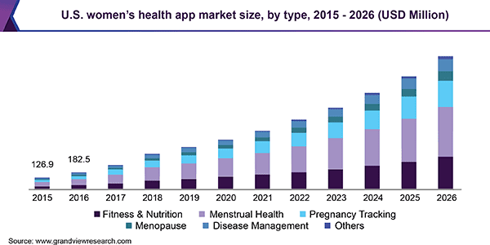
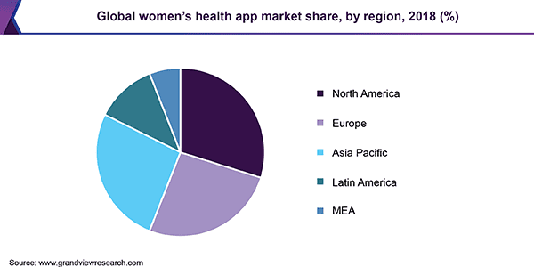
Women’s health app market

Slide 8
Future updates to the solution if any
Daily tips regarding proper nutrition of child after birth.
Personalized bot for interaction.
Make
appointments directly through the app.

